Slide 1


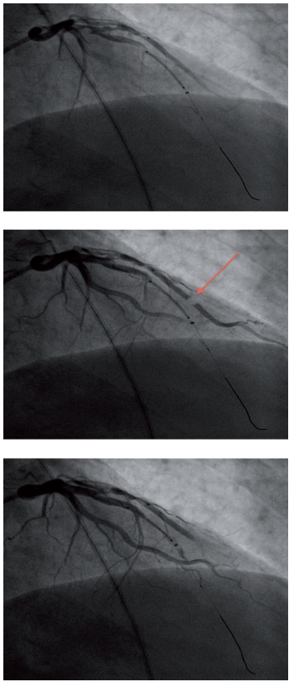

The prevention and management of
complications during percutaneous coronary intervention
Figure 11
Coronary air embolismAir (red arrow) injected down a diagonal branch during a PPCI resulting in vessel occlusion.
Christian Roguelov, Adel Aminian, Olivier Muller, Tito Kabir, Eric Eeckhout
©2025 Europa Group - All rights reserved.

