Slide 1


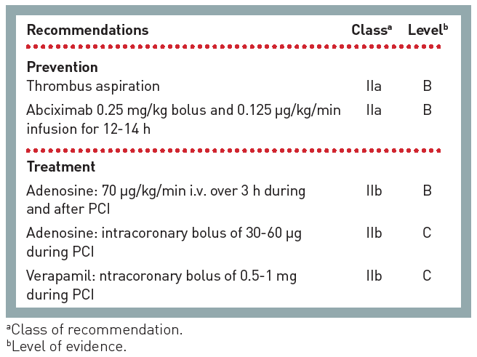

The prevention and management of
complications during percutaneous coronary intervention
Figure 13
ESC guidance for the management of no-reflow
Christian Roguelov, Adel Aminian, Olivier Muller, Tito Kabir, Eric Eeckhout
©2025 Europa Group - All rights reserved.

