Slide 1


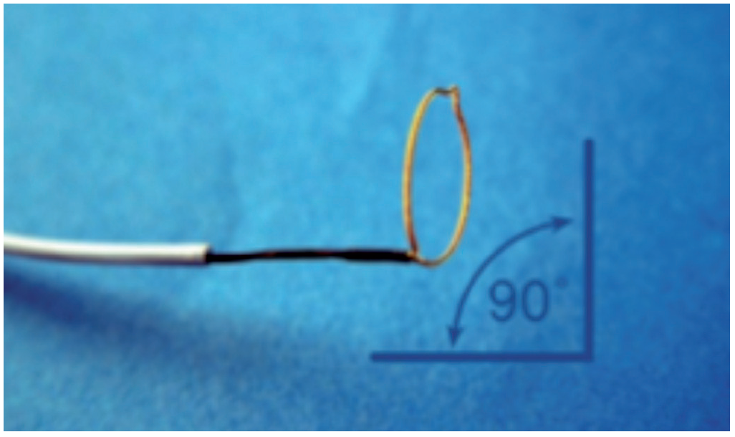

The prevention and management of
complications during percutaneous coronary intervention
Figure 16
Distal portion of a gooseneck snare
Christian Roguelov, Adel Aminian, Olivier Muller, Tito Kabir, Eric Eeckhout
©2025 Europa Group - All rights reserved.

