Slide 1


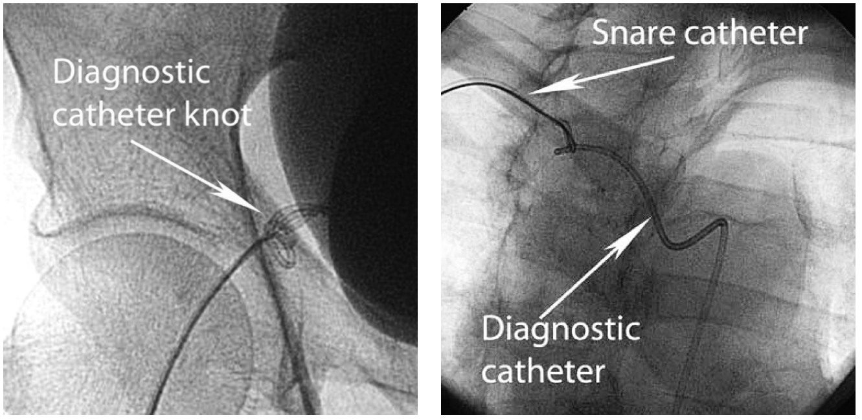

The prevention and management of
complications during percutaneous coronary intervention
Figure 18A
Disentangling a catheter knoti Diagnostic catheter knot in the iliac arteryii Snare grasping the distal end of a knotted catheter while traction is applied.
Christian Roguelov, Adel Aminian, Olivier Muller, Tito Kabir, Eric Eeckhout
©2025 Europa Group - All rights reserved.

