Slide 1


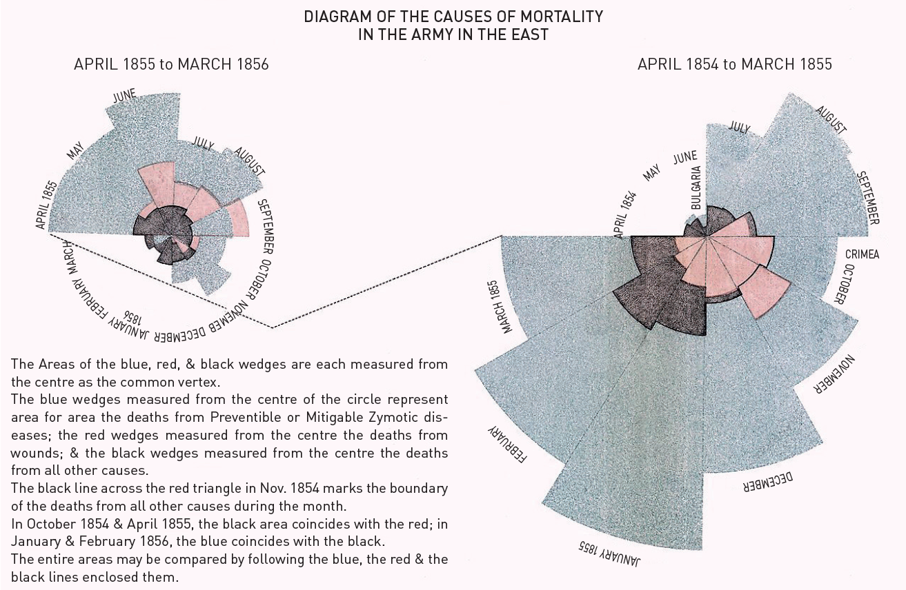

The prevention and management of complications during percutaneous coronary intervention
Figure 21
Mortality statistics“Polar area” chart from Nightingale (1858) showing the earliest documented attempt in Europe to evaluate mortality at hospitals receiving wounded soldiers from the Crimean war.
Christian Roguelov, Adel Aminian, Olivier Muller, Tito Kabir, Eric Eeckhout
©2025 Europa Group - All rights reserved.

