Slide 1


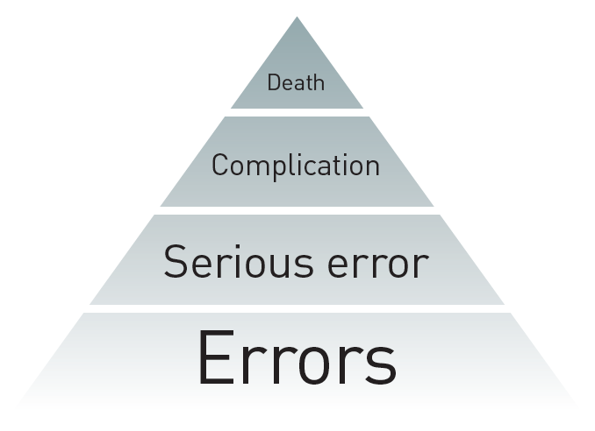

The prevention and management of complications during percutaneous coronary intervention
Figure 22
Errors and complications
Christian Roguelov, Adel Aminian, Olivier Muller, Tito Kabir, Eric Eeckhout
©2025 Europa Group - All rights reserved.

