Slide 1


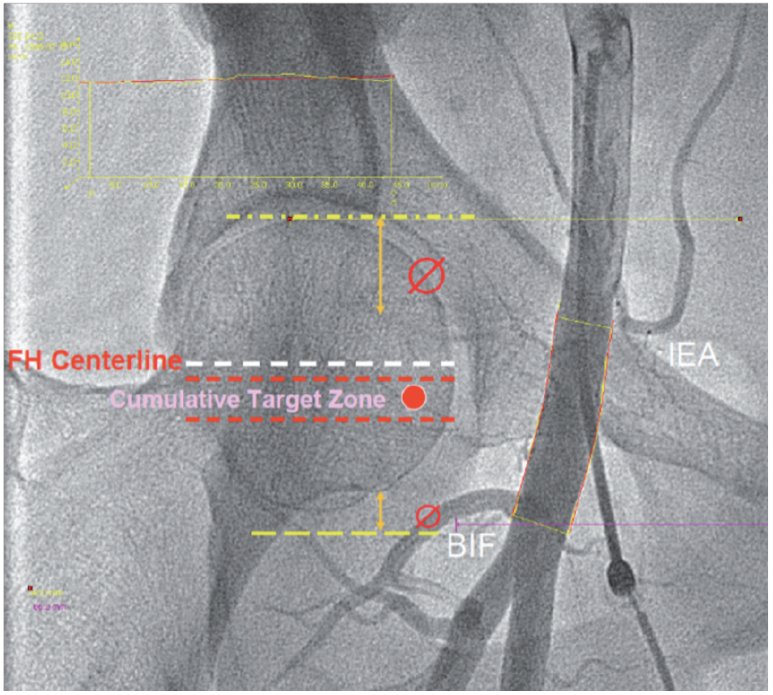

The prevention and management of
complications during percutaneous coronary intervention
Figure 3
Fluoroscopic guidance to find the target zone for femoral punctureBIF (Femoral bifurcation), IEA (Inferior Epigastric Artery), FH (Femoral Head) (Courtesy Prof. Turi).
Christian Roguelov, Adel Aminian, Olivier Muller, Tito Kabir, Eric Eeckhout
©2025 Europa Group - All rights reserved.

