Slide 1


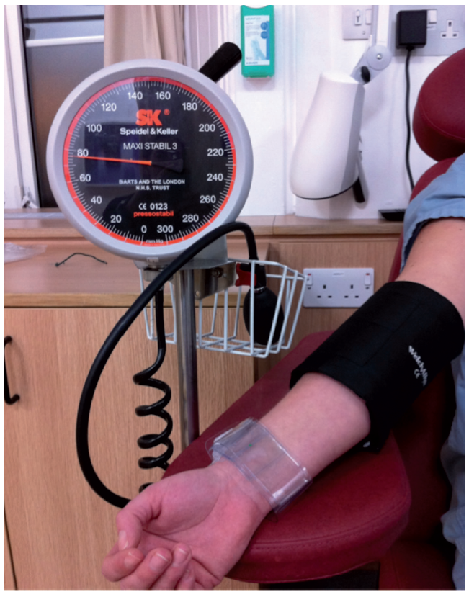

The prevention and management of
complications during percutaneous coronary intervention
Figure 4
Management of forearm haematomaEarly recognition of forearm haematoma and application of pressure 15mmHg below systolic has been suggested as a means of avoiding surgical fasciotomy. Usually 2 periods of 15 minutes are required to control bleeding.
Christian Roguelov, Adel Aminian, Olivier Muller, Tito Kabir, Eric Eeckhout
©2025 Europa Group - All rights reserved.

