Slide 1


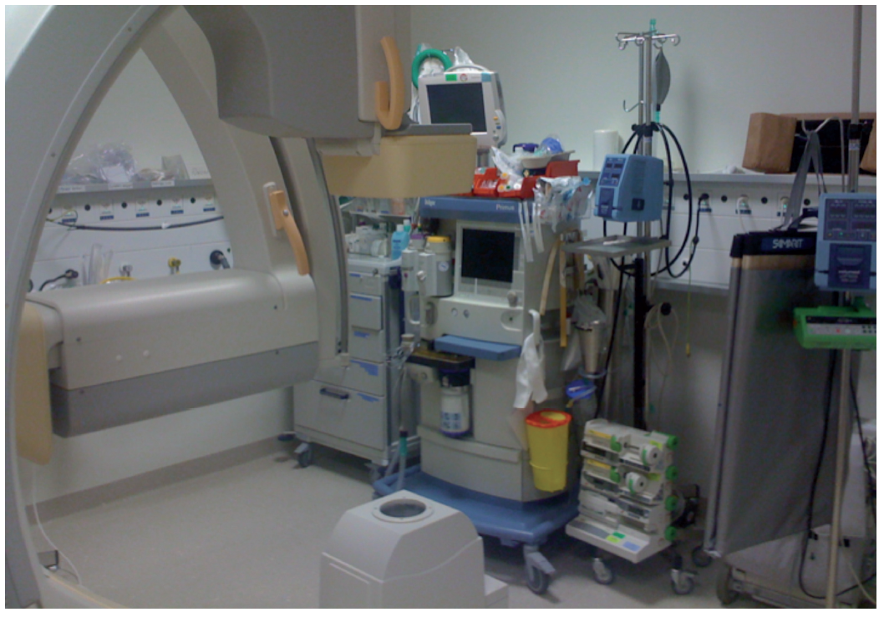

The prevention and management of complications during percutaneous coronary intervention
Figure 7
Anaesthetic machine and resuscitation equipmentThese must be present within easy access and be checked daily.
Christian Roguelov, Adel Aminian, Olivier Muller, Tito Kabir, Eric Eeckhout
©2025 Europa Group - All rights reserved.

