Slide 1


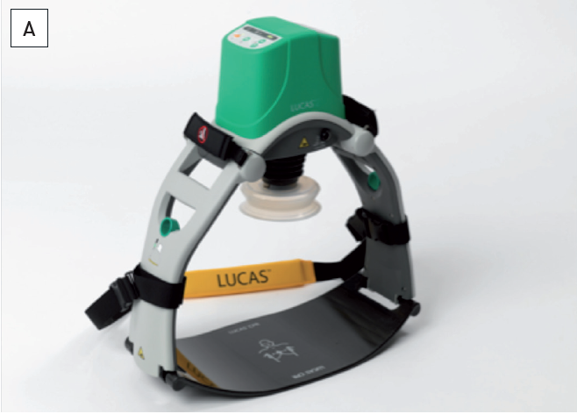

The prevention and management of complications during percutaneous coronary intervention
Figure 8A
LUCASTM (Courtesy of Lund, Sweden)Automatic chest compressions can be delivered and radiographic images obtained simultaneously in all projections except AP.
Christian Roguelov, Adel Aminian, Olivier Muller, Tito Kabir, Eric Eeckhout
©2025 Europa Group - All rights reserved.

