Slide 1


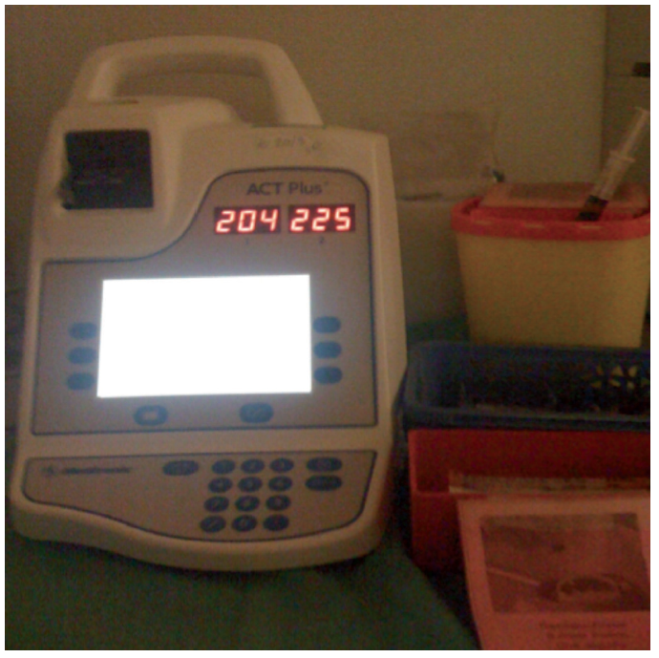

The prevention and management of complications during percutaneous coronary intervention
Figure 9
Anticoagulation with unfractionated heparinAll interventions should be covered by heparin and ACT checked if a procedure >60 minutes.
Christian Roguelov, Adel Aminian, Olivier Muller, Tito Kabir, Eric Eeckhout
©2025 Europa Group - All rights reserved.

