Slide 1


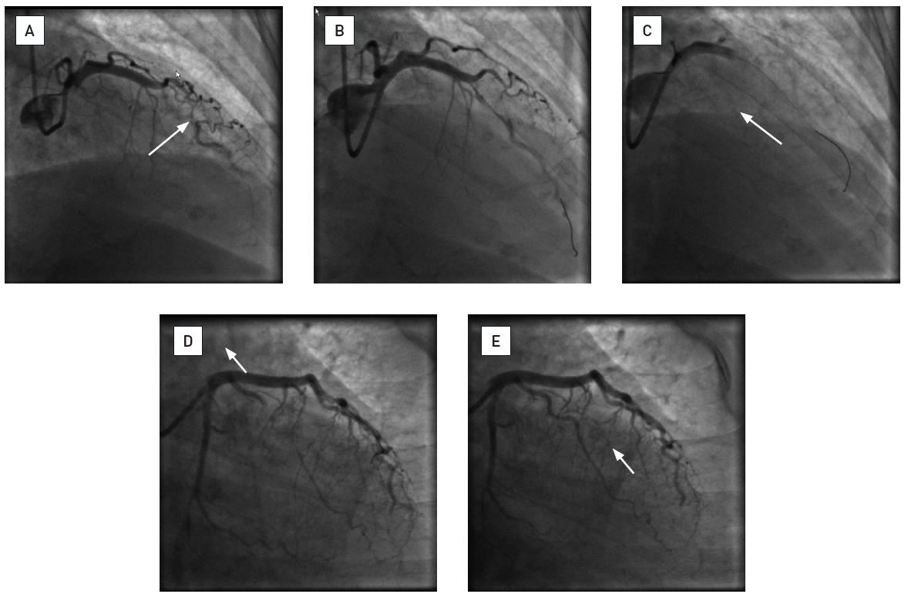

The prevention and management of
complications during percutaneous coronary intervention
Illustrative case 5
Iatrogenic left main thrombusCase illustration of iatrogenic left main thrombosis.(courtesy of Dr. G. Wilkins, Dunedin Hospital, Dunedin, New Zealand).A. Thrombotic subocclusion of a mid left anterior descending artery (white arrow).B. Opening of the artery after manual thrombectomy.C. Iatrogenic thrombotic occlusion of the left main stem after repeated thrombectomy probably caused by fragmentation and embolisation of organised thrombus from the thrombectomy catheter upon retrieval.D. Restoration of flow into the left anterior descending after cleaning of the guiding catheter, repeated thrombectomy, intracoronary abciximab administration.E. Restoration of flow in the intermediate branch after repeated thrombectomy.
Christian Roguelov, Adel Aminian, Olivier Muller, Tito Kabir, Eric Eeckhout
©2025 Europa Group - All rights reserved.

