Slide 1


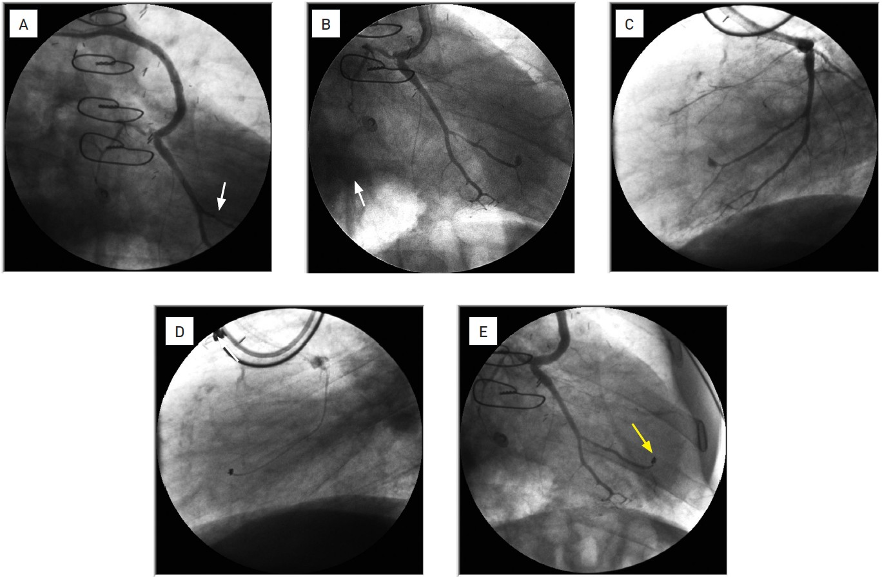

The prevention and management of complications during percutaneous coronary intervention
Illustrative case 7
Coronary perforation sealed using intravascular coilsCase illustration of a type V coronary perforation.A. Saphenous vein graft to a marginal branch after stenting. Folded guidewire (white arrow) in the distal marginal branch inducing a type V perforation.B. Small type V perforation at the tip of the hydrophilic guidewire.C. Same image in the lateral view.D. Delivery of a coil at the site of the perforation (microcatheter in place).E. Final image after coil delivery (yellow arrow).
Christian Roguelov, Adel Aminian, Olivier Muller, Tito Kabir, Eric Eeckhout
©2025 Europa Group - All rights reserved.

