Slide 1


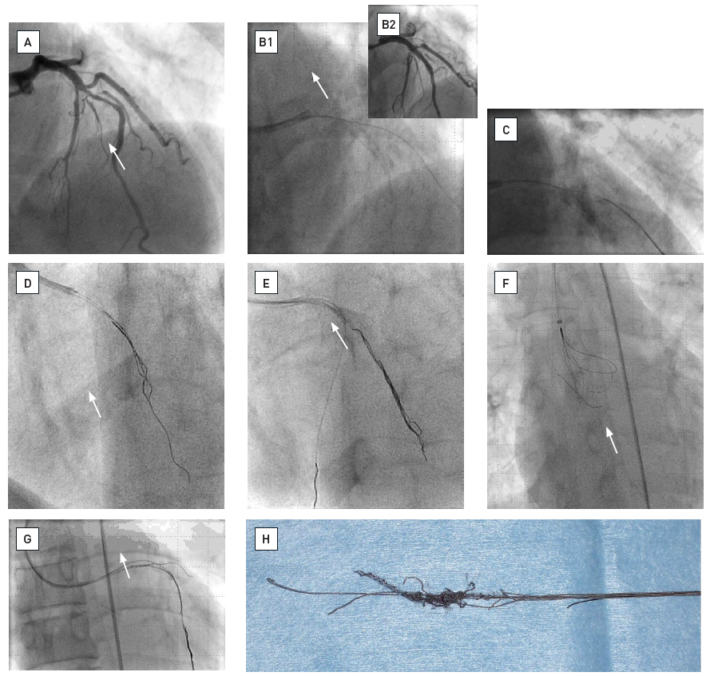
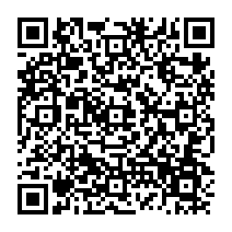
The prevention and management of
complications during percutaneous coronary intervention
Illustrative case 8
Retrieval of retained equipmentCase illustration of different techniques to retrieve a broken guidewire.A. Mid left anterior descending artery (LAD) and diagonal branch stenosis prior to coronary intervention.B. 1. Image after stent implantation and post dilatation in the mid LAD showing a jailed wire in the diagonal branch. 2. Image after contrast injection.C. Image of a broken coronary wire fragment in the diagonal branch.D. Failed attempt to snare the wire.E. Wire wrap technique succeeds partially in retrieving the wire.F. Successful snaring of a part of the wire in the ascending aorta.G. Second attempt at wire wrap with a combined balloon – wires system.H. Retrieved material : stent – balloon – broken wire – wire wrap system.
Christian Roguelov, Adel Aminian, Olivier Muller, Tito Kabir, Eric Eeckhout
©2025 Europa Group - All rights reserved.

