Slide 1


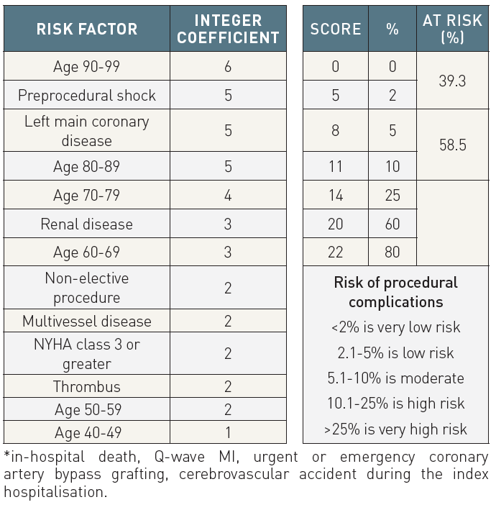

The prevention and management of complications during percutaneous coronary intervention
Table 5A
Prediction of in-hospital complications following PCIInitial validation based on n=9035 procedures on 7457 patients (2000-2005).
Christian Roguelov, Adel Aminian, Olivier Muller, Tito Kabir, Eric Eeckhout
©2025 Europa Group - All rights reserved.

