Slide 1


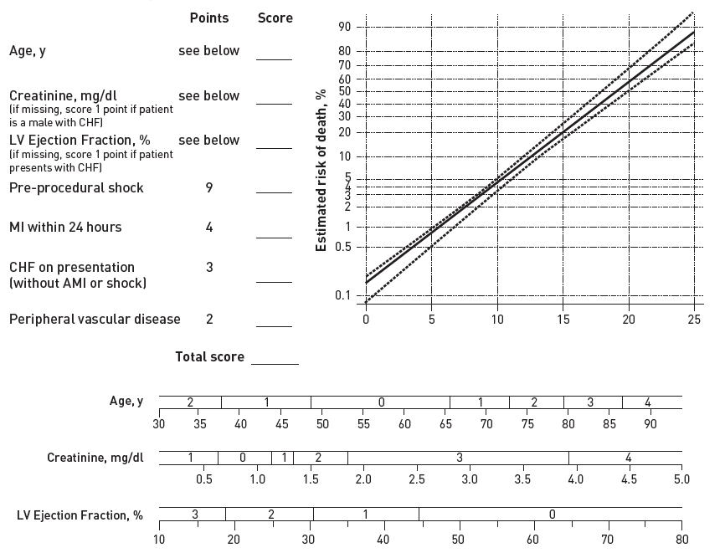

The prevention and management of complications during percutaneous coronary intervention
Table 5B
The original scoring system ( Table 5A ) was recalibrated and revalidated on 309,351 patients from the NCDR (2004-2007)
Christian Roguelov, Adel Aminian, Olivier Muller, Tito Kabir, Eric Eeckhout
©2025 Europa Group - All rights reserved.

