Slide 1


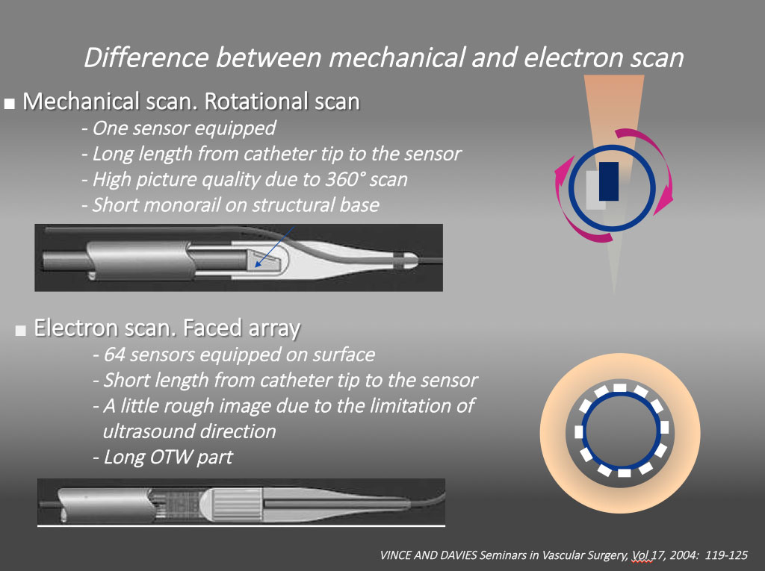

The role of imaging in coronary chronic total occlusion intervention
Figure 1
Different intravascular ultrasound systems A mechanical scan with a lower profile catheter (Atlantis and Opti cross, Boston, USA , Naviocus, Altaview Terumo, Japan, Revolution, Volcano, Philips) and a solid-state phased array scan (Eagle eye, Volcano, Philips). While mechanical Opti cross can provide high detailed axial resolution image ( 35-50 micro), solid state of Eagle Eye provides images of 60-170 micron.
Masahisa Yamane, Kenya Nasu, Masaaki Okutsu, Makoto Sekiguchi
©2025 Europa Group - All rights reserved.

