Slide 1


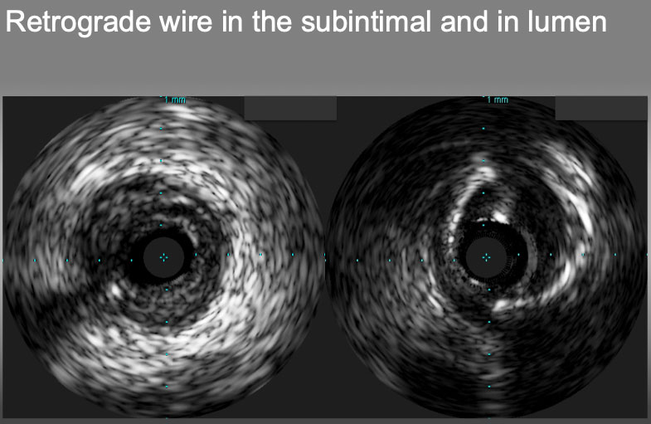

The role of imaging in coronary chronic total occlusion intervention
Figure 10
Retrograde wire in the subintimal plaque (left) and in the true lumen(right).
Masahisa Yamane, Kenya Nasu, Masaaki Okutsu, Makoto Sekiguchi
©2025 Europa Group - All rights reserved.

