Slide 1


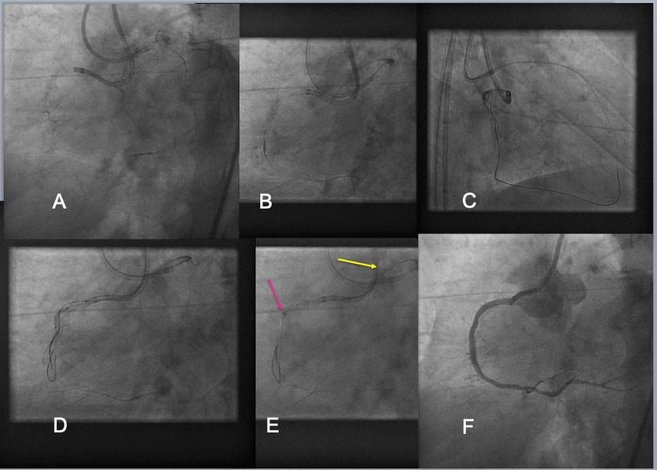

The role of imaging in coronary chronic total occlusion intervention
Figure 11
Guide Catheter Extension Assisted Reverse CART in RCA CTO. A RCA CTO, which was long ( from the ostium to the distal PDA-PLV bifurcation) and heavily calcified CTO, was approached by bilateral 7F Guide systems (A). Bilateral approach was made using Antegrade Gaia Next 3(Asahi Intecc) and retrograde Gaia Next 3 (B), but attempt to reverse CART in the proximal bending failed(C). A 2 nd antegrade wire of Confianza Pro 12g(Asahi Intecc) was advanced over a dual lumen catheter and placed different layer of calcified CTO. After 1.5-2.0mm balloon dilation over the 2 nd guide wire over the proximal to mid segments of occlusion(D), a 6F Guide liner (Teleflex) was advanced into the CTO segment(a red arrow in E), where a retrograde Gaia Next 2 wire entered the extension (a yellow wire in E), and a wire exchange and externalization was completed by advancing a retrograde microcatheter into the extension over a trapping balloon. After balloon dilation and DES deployment, an excellent result was obtained(F).
Masahisa Yamane, Kenya Nasu, Masaaki Okutsu, Makoto Sekiguchi
©2025 Europa Group - All rights reserved.

