Slide 1


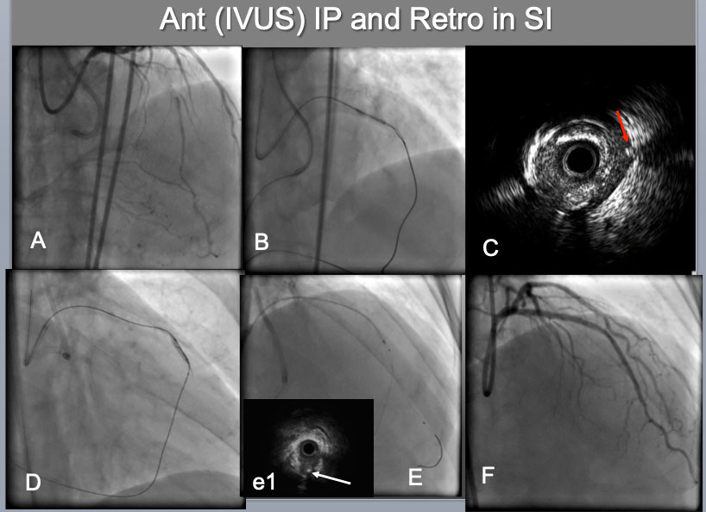

The role of imaging in coronary chronic total occlusion intervention
Figure 12a
IVUS guided intimal optimization in retrograde approach A proximal-mid LAD CTO, which was calcified, bending (A),was approached bilaterally by both 7F systems(B). Since difficulties were encountered on reverse CART attempt, IVUS was interrogated(C), which indicated an IVUS probe in the Intra plaque(IP) and a retrograde wire in the subintimal space ( a red arrow in C). Therefore IP side wire was advanced deeper ( more distal ) and balloon was dilated there(D), which resulted in successful reverse CART. After successful retrograde wire externalization and placement of a 2 nd wire in the distal LAD (E), IVUS confirmed a distal true lumen, a bifurcation with a retrograde septal wire( a white arrow in (e1) and the CTO IP tracking. A final result (F).
Masahisa Yamane, Kenya Nasu, Masaaki Okutsu, Makoto Sekiguchi
©2025 Europa Group - All rights reserved.

