Slide 1


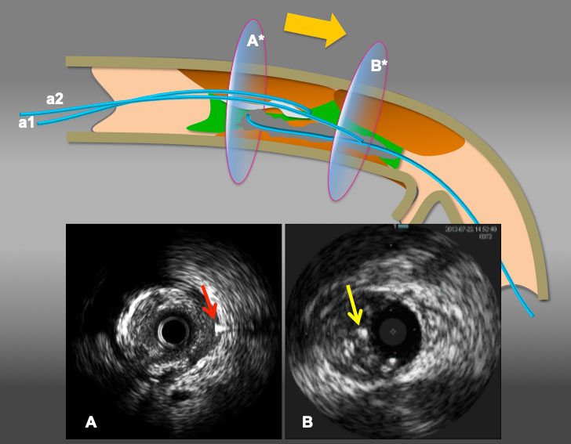

The role of imaging in coronary chronic total occlusion intervention
Figure 12b
Illustration to resolve antegrade wire (IVUS) in IP and retrograde wire in subintima situation. When a retrograde wire ( a red arrow in A) stays inside of subintimal space(A), reverse CART can be challenging. However, when a simple rule applies (move intraplaque wire ahead), as in A* in broad yellow arrow arrow( from antegrade wire a1 to a2), the maneuver provides a antegrade wire to slide into the subintima (an yellow arrow in B) ( with or without a knuckle wire), resulting in subintima-subintima situation as illustrated in (B*) and successful retrograde wire crossing by reverse CART.
Masahisa Yamane, Kenya Nasu, Masaaki Okutsu, Makoto Sekiguchi
©2025 Europa Group - All rights reserved.

