Slide 1


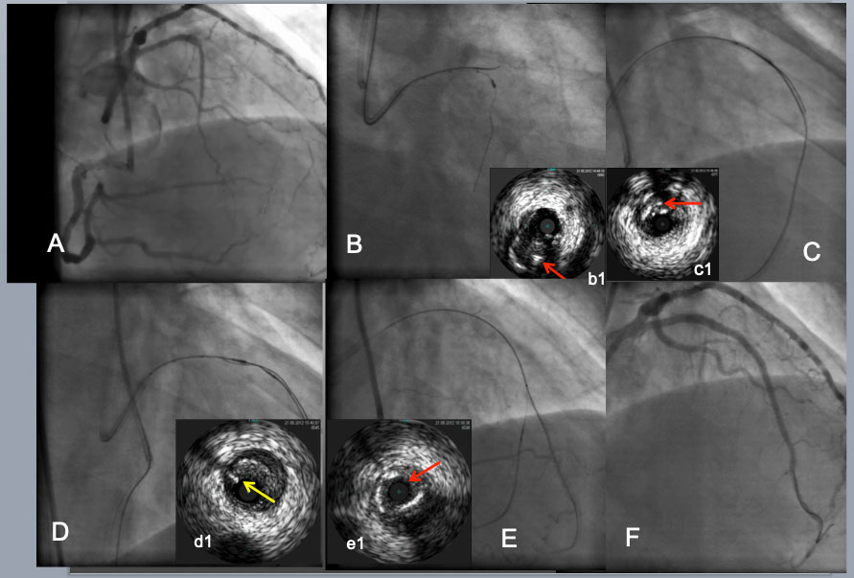

The role of imaging in coronary chronic total occlusion intervention
Figure 13a
IVUS guided intimal optimization in retrograde approach. As an initial step to a CTO with a large side branch(B), IVUS from the branch enabled a Gaia 2 to puncture the proximal CTO cap (a red arrow in b1indicated the wire in the intimal plaque(IP). After difficulty in reverse CART attempt (C). IVUS located a retrograde wire in the IP( a red arrow in c1). Further advancement of retrograde wire resulted in subintimal position ( a yellow arrow in d1) over a pull back IVUS in more proximal LAD(D) and successfully entered the antegrade guide. After a retrograde wire exchanged to an externalization wire and a placement of a 2 nd wire into a distal LAD(E), IVUS confirmed the distal true lumen(a red arrow in e1). A final result (F).
Masahisa Yamane, Kenya Nasu, Masaaki Okutsu, Makoto Sekiguchi
©2025 Europa Group - All rights reserved.

