Slide 1


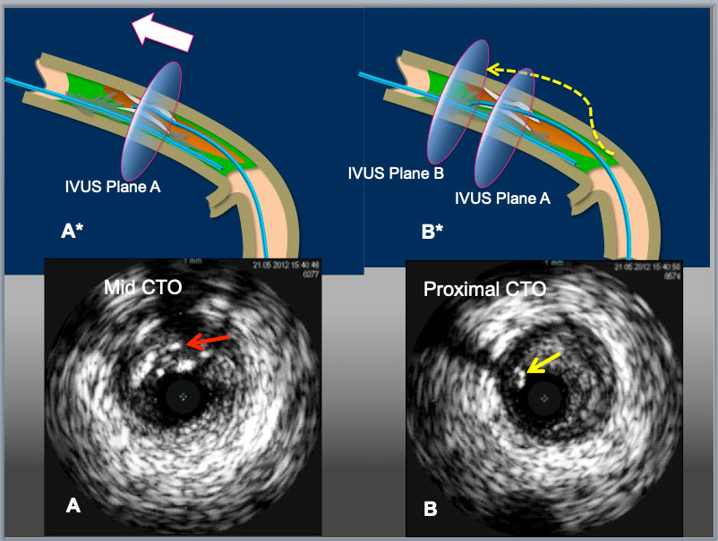

The role of imaging in coronary chronic total occlusion intervention
Figure 13b
Illustration to resolve retrograde wire in IP and antegrade wire (IVUS) in subintima situation. When a retrograde wire ( a red arrow in A) stays inside of partially calcified encircled intimal plaque (A), reverse CART can be challenging. However, when a simple rule applies (move intraplaque wire ahead), as in A* in broad white arrow, the maneuver provides a retrograde wire to slide into the subintima in (an yellow arrow in B*) ( with or without a knuckle wire), resulting in subintima-subintima situation as illustrated in (B*) and successful retrograde wire crossing upon a balloon dilation of reverse CART.
Masahisa Yamane, Kenya Nasu, Masaaki Okutsu, Makoto Sekiguchi
©2025 Europa Group - All rights reserved.

