Slide 1


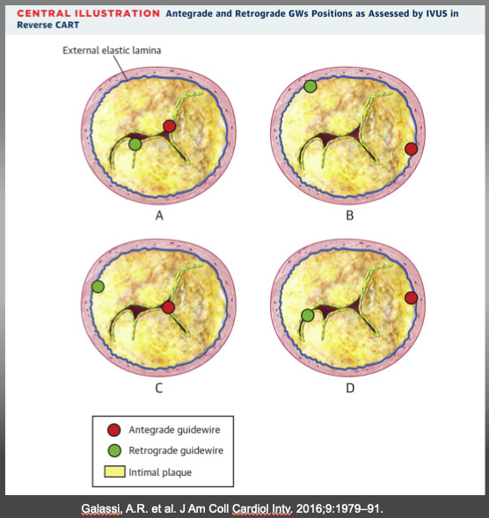

The role of imaging in coronary chronic total occlusion intervention
Figure 14
(A) Antegrade and retrograde guidewires (GWs) in intimal plaque. This is the ideal scenario to make a connecting channel, after antegrade balloon dilation in chronic total occlusion body. (B) Antegrade and retrograde GWs in subintimal space. Another ideal condition in which it is easy to create a connection in the same space after balloon dilation. (C) Antegrade GW in intimal plaque but retrograde GW in subintimal space. Very complex situation in which it is crucial to create a medial disruption with a proper balloon sizing to create connection between the 2 GWs. In case of failure, is possible to advance antegrade wire distally to reach subintimal space and create the previous situation (subintimal–subintimal). (D) Antegrade wire in subintimal space but retrograde wire in intimal plaque, often very calciÃ¯Â¬Âed. The most complex situation because antegrade balloon dilation usually enlarges subintimal space (increasing intramural hematoma) without any possibility to create connection between the 2 GWs. In this situation, the connection is usually achieved by pushing the retrograde wire in subintimal space (usually with retrograde knuckle technique). In such a complex case, a possible less used alternative is a retrograde balloon dilation (original CART) to create medial dissection and facilitate antegrade GW connection with retrograde GW. CART=controlled antegrade retrograde tracking; IVUS = intravascular ultrasound. Galassi, A.R. et al. J Am Coll Cardiol Intv. 2016;9:1979–91.
Masahisa Yamane, Kenya Nasu, Masaaki Okutsu, Makoto Sekiguchi
©2025 Europa Group - All rights reserved.

