Slide 1


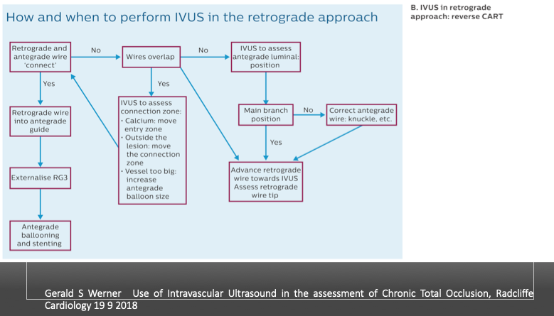

The role of imaging in coronary chronic total occlusion intervention
Figure 15b
Gerald S Werner Use of Intravascular Ultrasound in the assessment of Chronic Total Occlusion, Radcliffe Cardiology 19 9 2018
Masahisa Yamane, Kenya Nasu, Masaaki Okutsu, Makoto Sekiguchi
©2025 Europa Group - All rights reserved.

