Slide 1


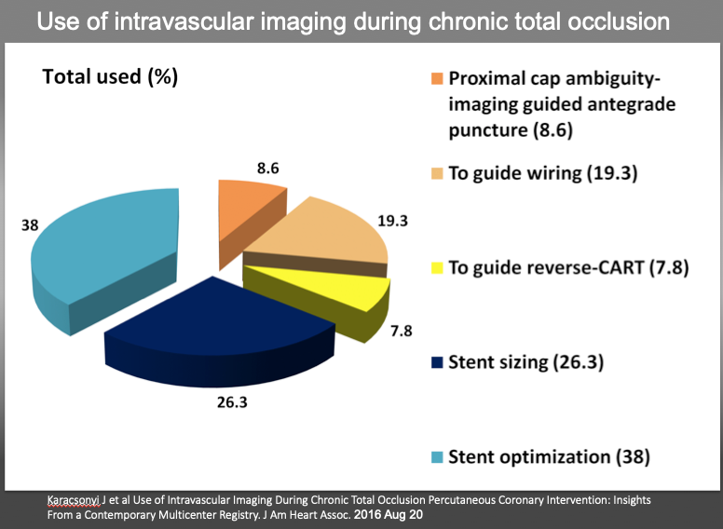

The role of imaging in coronary chronic total occlusion intervention
Figure 16
Use of intravascular imaging during chronic total occlusion percutaneous coronary intervention. CART indicates controlled antegrade and retrograde tracking and dissection.
Masahisa Yamane, Kenya Nasu, Masaaki Okutsu, Makoto Sekiguchi
©2025 Europa Group - All rights reserved.

