Slide 1


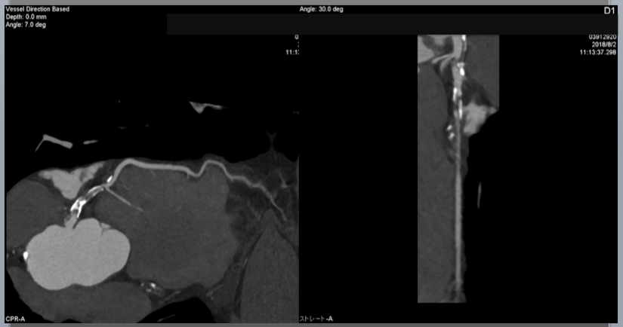

The role of imaging in coronary chronic total occlusion intervention
Figure 18
Curved multiplanar reconstruction( cMPR) image and stretched MPR image. cMPR is useful to visualize the whole coronary tree in a single slice ( therefore, the images are reformatted along a curved plane).
Masahisa Yamane, Kenya Nasu, Masaaki Okutsu, Makoto Sekiguchi
©2025 Europa Group - All rights reserved.

