Slide 1


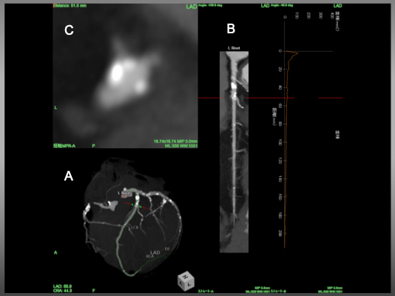

The role of imaging in coronary chronic total occlusion intervention
Figure 19
Angiographic view B) Stretched MPR image and C) Cross sectional view of LAD. Red line indicated a corresponding level of the vessel . In figure C, an eccentric calcified plaque locates in 10 o'clock direction, while take-off of the diagonal bifurcates at 7-8 o'clock.
Masahisa Yamane, Kenya Nasu, Masaaki Okutsu, Makoto Sekiguchi
©2025 Europa Group - All rights reserved.

