Slide 1


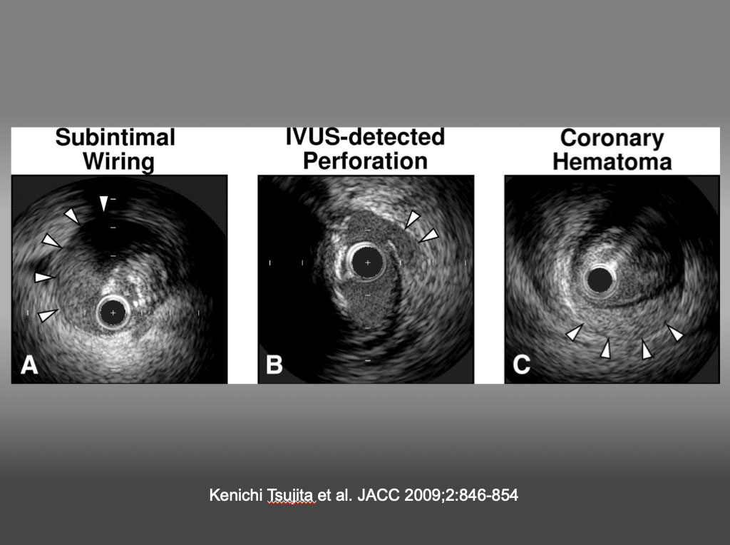

The role of imaging in coronary chronic total occlusion intervention
Figure 2
Representative IVUS Images (A) Subintimal wiring was defined as the intravascular ultrasound (IVUS) catheter located in the subintimal space (arrowheads, absence of arterial wall 3 layers) (note the collapsed true lumen at 2 o'clock). (B) The IVUS-detected coronary perforation was defined as blood speckle outside the vessel (arrowheads) and/or tear of the adventitia despite a lack of angiographic extravasation. (C) Coronary hematoma was defined as an accumulation of blood (arrowheads) recognized typically as a crescent-shaped homogeneous hyperechoic structure with straightening of the internal elastic membrane. Kenichi Tsujita et al. JACC 2009;2:846-854
Masahisa Yamane, Kenya Nasu, Masaaki Okutsu, Makoto Sekiguchi
©2025 Europa Group - All rights reserved.

