Slide 1


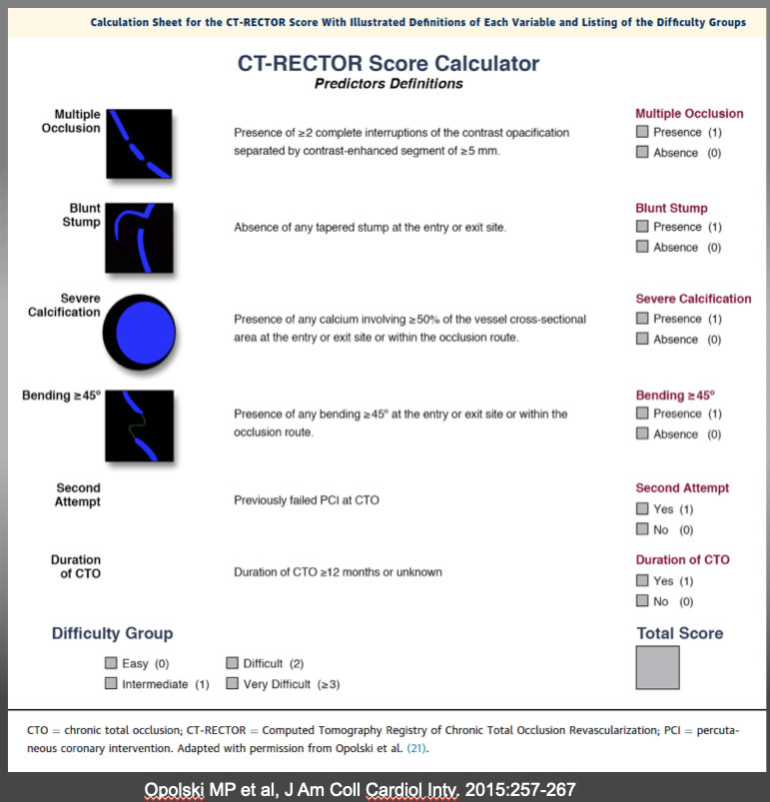

The role of imaging in coronary chronic total occlusion intervention
Figure 20
The CT-RECTOR Score Calculator Calculation sheet for the CT-RECTOR (Computed Tomography Registry of Chronic Total Occlusion Revascularization) score with illustrated definitions of each variable and listing of the difficulty groups. Recent development of CTA co-registration images will further facilitate precise wiring on “a road mapping”. One study has emerged that pre-procedural CTA contributes positively in success rate of CTO-PCI (10). A Wider application of these imaging and “pre-procedural navigation” will further facilitate our understanding, classification, and treatment strategies of the heterogeneous groups of the CTO. K-CTO score Opolski MP et al, J Am Coll Cardiol Intv. 2015:257-267
Masahisa Yamane, Kenya Nasu, Masaaki Okutsu, Makoto Sekiguchi
©2025 Europa Group - All rights reserved.

