Slide 1


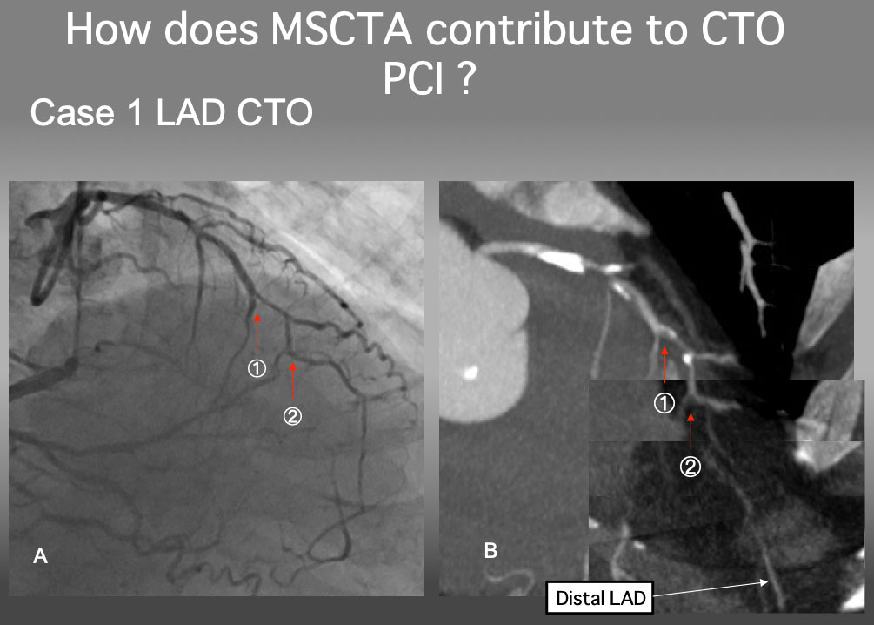

The role of imaging in coronary chronic total occlusion intervention
Figure 21
Case 1. Clarify a proximal cap ambiguity The proximal cap of this CTO seems to be at 1, but a serial MIP images confirmed that the point 2 is a true proximal cap. The detailed analysis of MSCTA can resolve an ambiguity of the CTO proximal cap.
Masahisa Yamane, Kenya Nasu, Masaaki Okutsu, Makoto Sekiguchi
©2025 Europa Group - All rights reserved.

