Slide 1


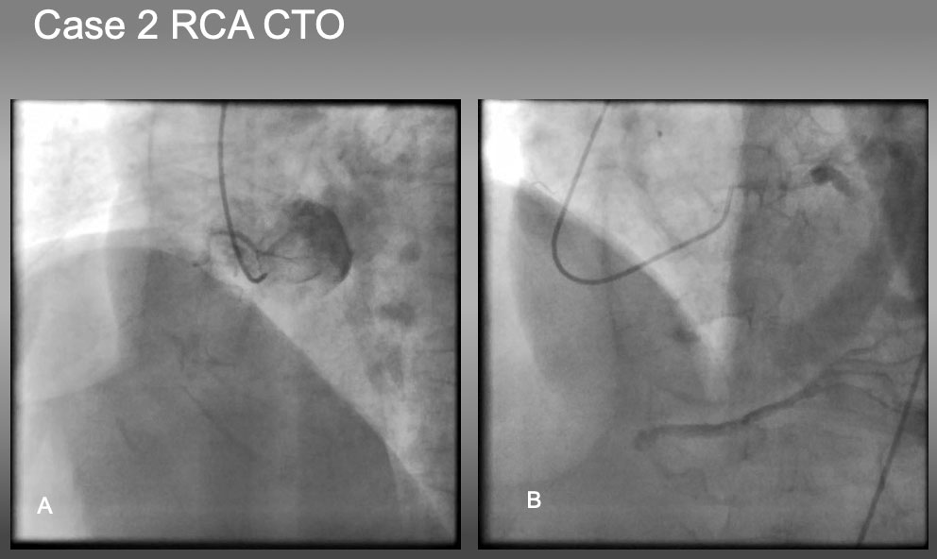

The role of imaging in coronary chronic total occlusion intervention
Figure 22a
Case 2. RCA CTO with ambiguous proximal and distal caps. The case is an RCA ostial CTO , but angiography fails to locate the proximal cap in (A), as well as distal cap in (B).
Masahisa Yamane, Kenya Nasu, Masaaki Okutsu, Makoto Sekiguchi
©2025 Europa Group - All rights reserved.

