Slide 1


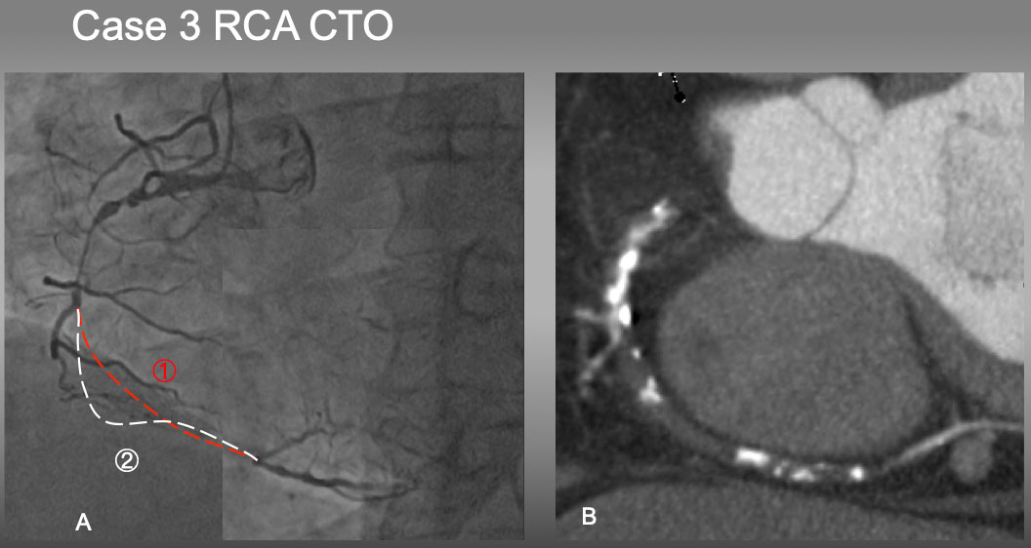

The role of imaging in coronary chronic total occlusion intervention
Figure 23
Case 3. It would have been difficult to estimate which is an occluded vessel course in 1 or 2 by an angiography alone (A). However, Slab MIP image (B) resolved the ambiguity of the course and characterized mainly a soft plaque with a few eccentric calcified plaques, which facilitated antegrade approach of PCI .
Masahisa Yamane, Kenya Nasu, Masaaki Okutsu, Makoto Sekiguchi
©2025 Europa Group - All rights reserved.

