Slide 1


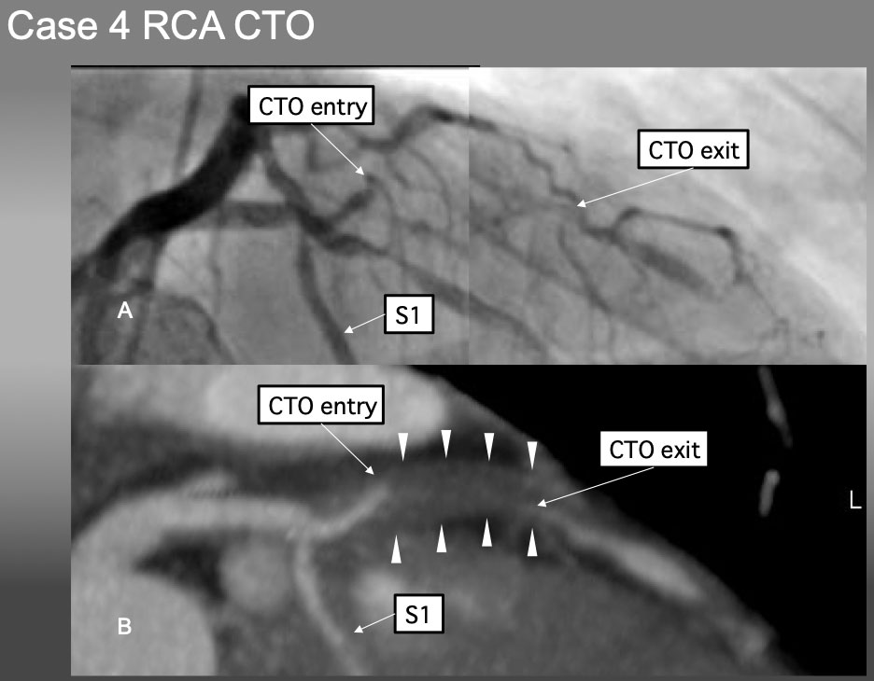

The role of imaging in coronary chronic total occlusion intervention
Figure 24
Case 4. It is very difficult to locate the proximal CTO cap by angiographic analysis alone in (A). Pre-procedural Slab MIP in B), however, not only provided the location, morphology of the proximal and distal caps, but also shed the light of disease process of positive remodeling without calcification.
Masahisa Yamane, Kenya Nasu, Masaaki Okutsu, Makoto Sekiguchi
©2025 Europa Group - All rights reserved.

