Slide 1


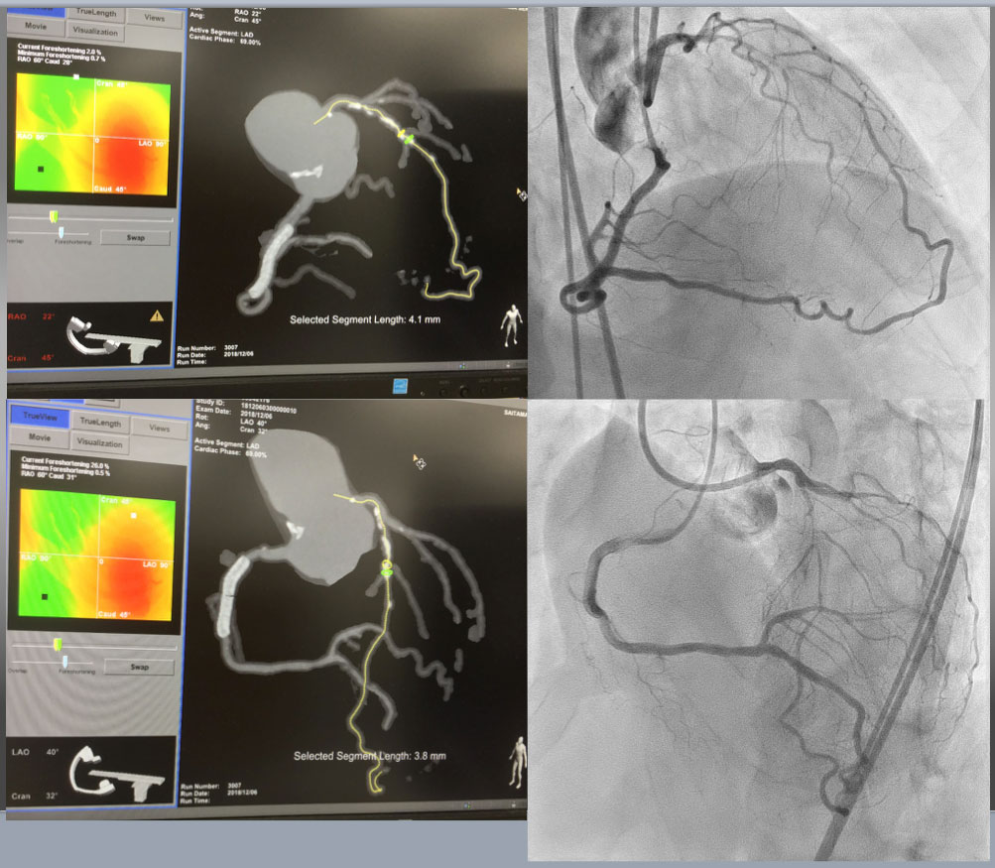

The role of imaging in coronary chronic total occlusion intervention
Figure 25a
Case 5. CTA Guided Co-Registration CTO-PCI Upper Left showed RAO Cranial projection of CTA on MIP filter( more enhancement of calcified segment), while upper right was bilateral coronary angiography on identical projection with CTA. Estimated CTO was short of 4.1mm, but moderately calcified continued form more proximal segment. Lower left and right provided CTA (MIP) on LAO cranial and bilateral angiography on the same view, respectively.
Masahisa Yamane, Kenya Nasu, Masaaki Okutsu, Makoto Sekiguchi
©2025 Europa Group - All rights reserved.

