Slide 1


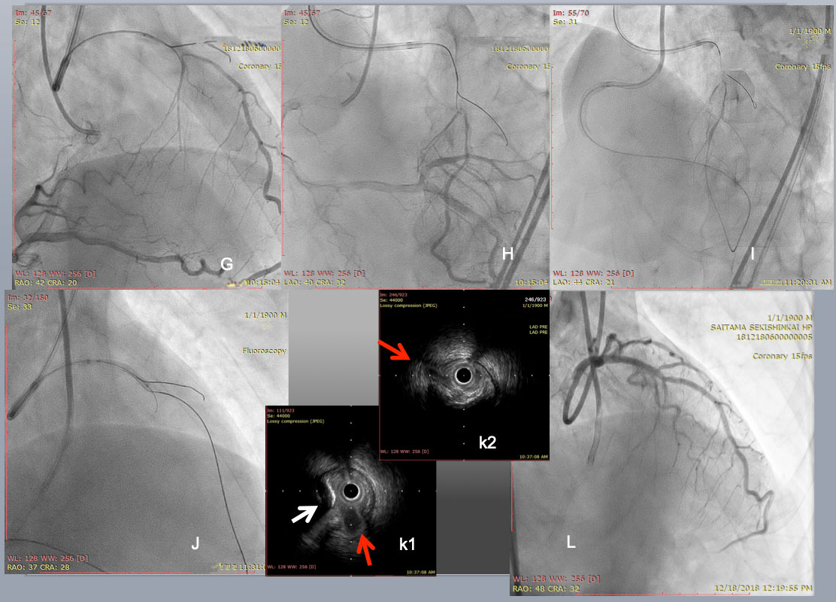

The role of imaging in coronary chronic total occlusion intervention
Figure 25c
PCI started with an antegrade approach, using a dual lumen catheter Sasuke (Asahi Intecc) with a 1 st wire in the diagonal branch (G), but a 2nd CTO wire of Miracle Neo 3g (Asahi Intecc in A) and Gaia Next 2 (Asahi Intecc in B)failed to cross distally. Since subintimal dissection obscured the bifurcation beyond the CTO (I), Retrograde approach was attempted through a large epicardial collateral. After a combination of a Suoh 03 and a Caravel micro catheter( both Asahi Intecc) crossed the collateral ( not shown), a retrograde Confianza Pro 12g succeeded in reverse CART (J). After successful guide wire externalization and 1.5 mm balloon dilation, IVUS revealed a septal branch and an eccentric calcified plaque ( a red and a white arrow, respectively in k1), and a diagonal branch in k2. After further balloon dilation and DES deployment, a satisfactory final results obtained. The case demonstrated that the use of Co-registration system streamlined to change the crossing strategy one from the other, since CTA highlighted a major hindrance of wire crossing, ie, short but eccentric calcified plaques in CTO segment.
Masahisa Yamane, Kenya Nasu, Masaaki Okutsu, Makoto Sekiguchi
©2025 Europa Group - All rights reserved.

