Slide 1


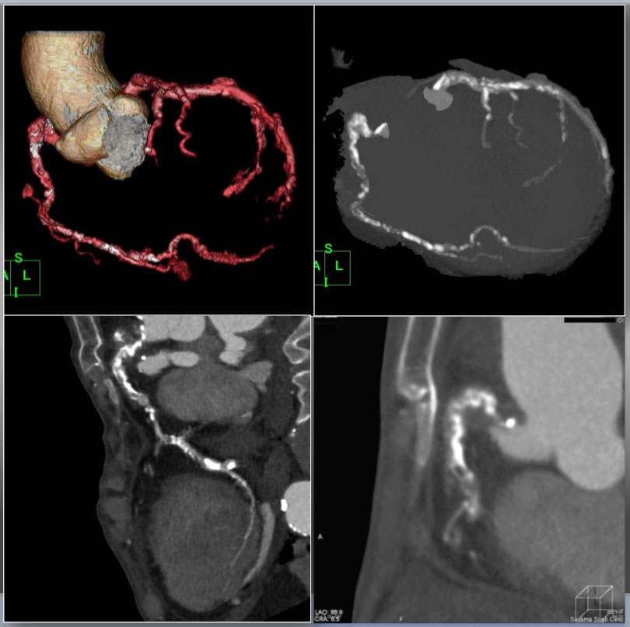

The role of imaging in coronary chronic total occlusion intervention
Figure 26a
Case 6. Heavily calcified, long, severely bended RCA CTO on permanent hemodialysis patient CTA performed after diagnostic CAG for support of complex PCI. VR (upper left), Angiographic MIP (upper right), curved MPR (lower left), and slab MIP (lower right) for CTA guided optimization for reverse CART. VR and disclosed proximal tortuosity, heavy calcification, >90 degree bend inside the CTO in an angiographic view, and >20mm occlusion length in curved MPR image. Slab MIP revealed dense calcification alongside of the ascending limb and at the distal segment of “Shepherd's crook” (Figure 4 C a).
Masahisa Yamane, Kenya Nasu, Masaaki Okutsu, Makoto Sekiguchi
©2025 Europa Group - All rights reserved.

