Slide 1


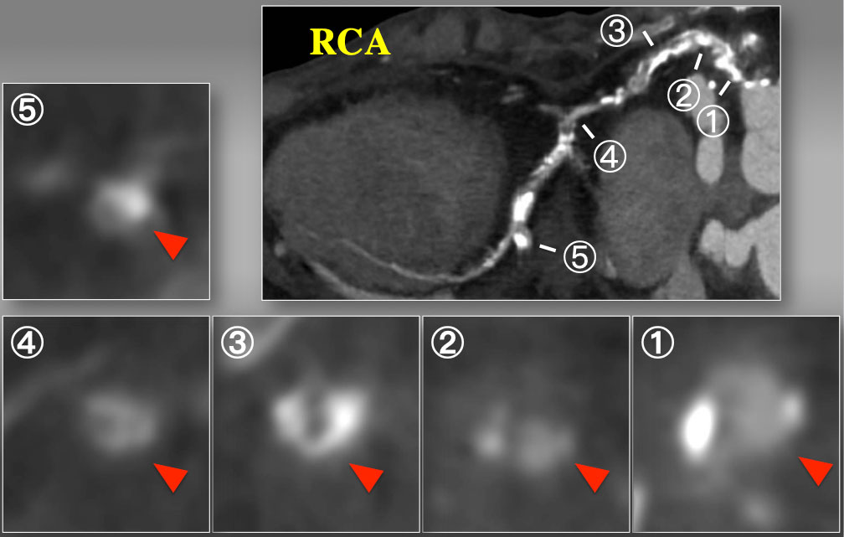

The role of imaging in coronary chronic total occlusion intervention
Figure 26b
Short axial cross sections of CTO on curved MPR. Cross sectional images disclosed partial calcium at the ostium (1), non-calcified contrast-filled segment (2), horse-shoe shaped calcium (3), and non-calcified inhomogeneous segment (4), and a focal calcification at the level of side branch. Therefore, CTA indicated complex, calcified proximal to mid RCA CTO over the bend, but each cross section analyses suggested some non-calcified vascular space will be connected through a spiraling manner, especially inner curvature of the proximal segment.
Masahisa Yamane, Kenya Nasu, Masaaki Okutsu, Makoto Sekiguchi
©2025 Europa Group - All rights reserved.

