Slide 1


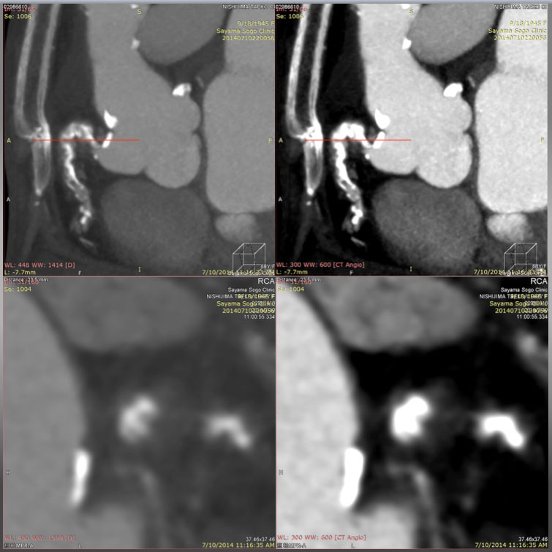

The role of imaging in coronary chronic total occlusion intervention
Figure 26c
A Slab MIP (upper left) reveals Cross section over the ascending and descending limbs of “Shepherd's crook” CTO on a window level (WL) 448 with a window width (WW) of 1414. Compared with the same cross section on a WL of 300 with a WW of 600 (upper right), the section on a wider width is in favor of avoiding overestimation of the calcified segments, and enabling one to recognize a non-calcified segment in more detail. Cross section of MPR (lower images, at the level of red line in the upper figures) could allow more detailed analysis of the vessel cross section on a wider WW (WL: 448, WW: 1414, lower left) than that of lower (WL: 300, WW: 600, lower right).
Masahisa Yamane, Kenya Nasu, Masaaki Okutsu, Makoto Sekiguchi
©2025 Europa Group - All rights reserved.

