Slide 1


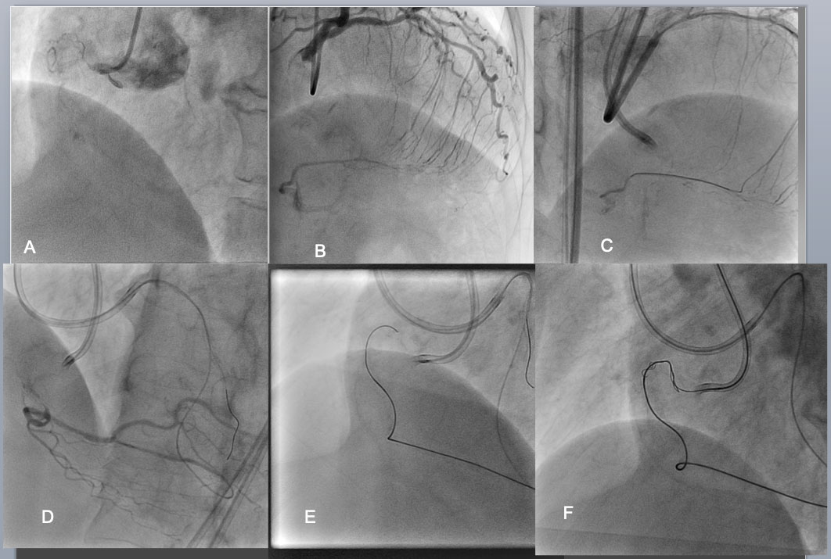

The role of imaging in coronary chronic total occlusion intervention
Figure 26d
Bilateral angiography shows an RCA CTO is consisted of an eccentric proximal cap, poorly defined target vessel, >20mm length of occlusion, bending inside, calcification, and well developed interventional collaterals (of the septum) (J-CTO Score of 4)(A,B). Considering those negative factors, bilateral approach was employed as a strategy. After successful crossing of the septal collateral by a Sion black (C), selective injection through the microcatheter highlighted a vessel course to the distal CTO (D). The wire of Gaia 1 st and 2 nd ( Asahi Intecc) was advanced over the arch of “Shepherd's crook” retrogradely with a close support of Corsair micro catheter(E).
Masahisa Yamane, Kenya Nasu, Masaaki Okutsu, Makoto Sekiguchi
©2025 Europa Group - All rights reserved.

