Slide 1


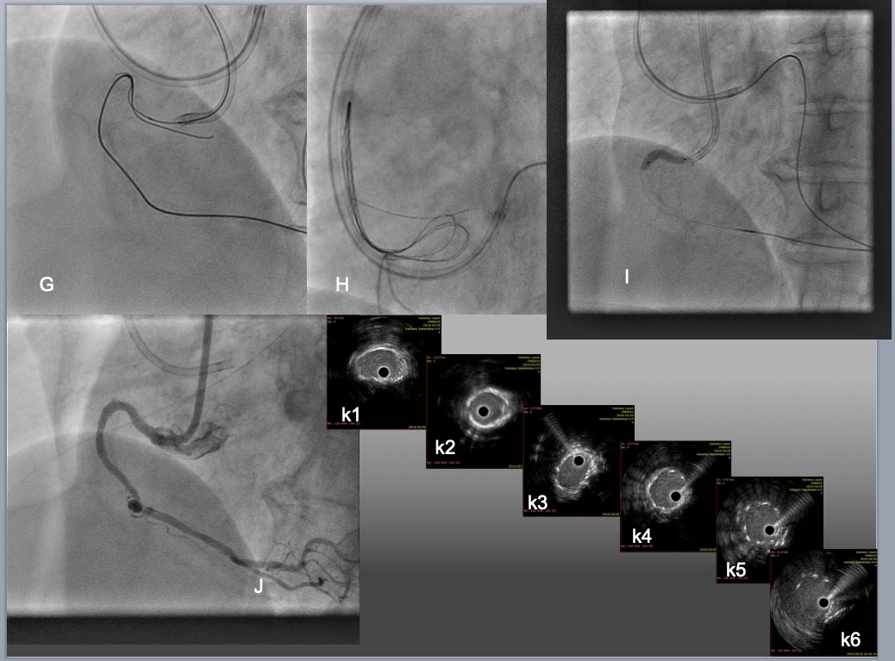

The role of imaging in coronary chronic total occlusion intervention
Figure 26e
While an antegrade wire of Gaia 2 was advanced across the "arch", creating overlapping in the proximal segment of CTO( G), reverse CART was implemented by dilation of 2.5mm antegrade balloon, which allowed the retrograde wide to exit into the aorta, where the wire exchanged to an RG3 330cm after the Corsair advanced into Aorta. The tip of the RG3 was snared by a Triple-head EnSnare 27-45mm (Merit medical, USA) through an 8F JR4.0 SH Guide(H), which enabled the catheter to engage an RCA ostium firmly by pulling the snare-wire through the guide and antegrade balloon dilation (I). Final result was obtained after 3 DES deployments over assistance of 7F Guide liner (Teleflex) and high pressure dilation of 3.0 mm NC balloon and 3.5 mm in the distal to the proximal, respectively. IVUS pull back confirmed satisfactory stent expansion and apposition over the calcified bending segments ( from middle RCA (k1) to bending( k3-k4), proximal(k5), and ostium (k6)).
Masahisa Yamane, Kenya Nasu, Masaaki Okutsu, Makoto Sekiguchi
©2025 Europa Group - All rights reserved.

