Slide 1


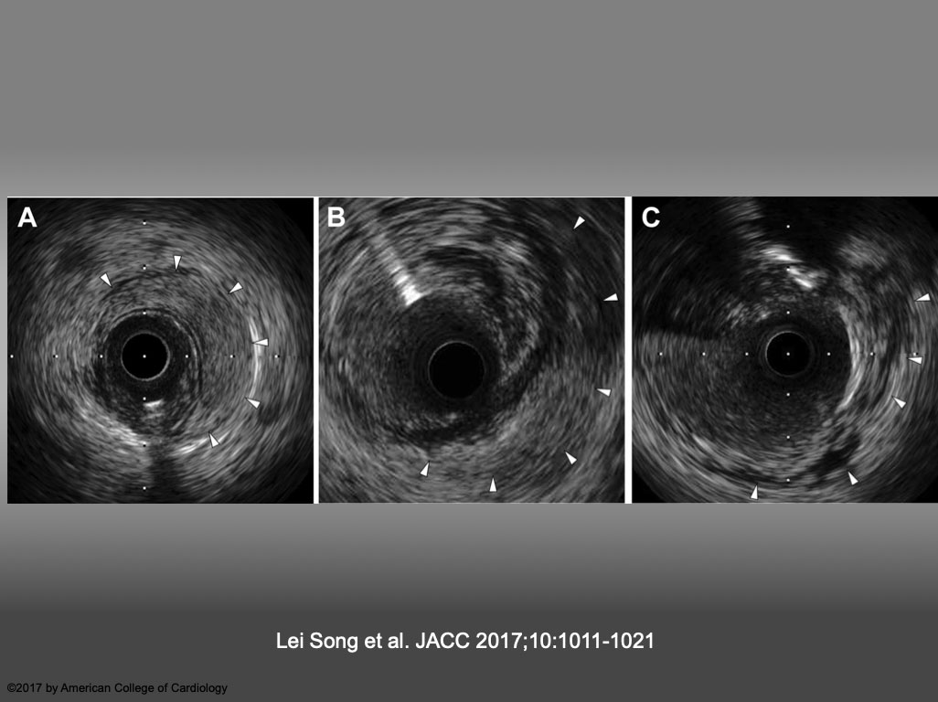

The role of imaging in coronary chronic total occlusion intervention
Figure 3
Representative Images of IVUS-VI (A) Intramedial hematoma, defined as an accumulation of blood (arrowheads) that appear as a crescent-shaped homogeneous hyperechoic structure within the medial space. (B) Perivascular hematoma, defined as an accumulation of blood (arrowheads) that appear as a crescent-shaped homogeneous hyperechoic structure outside the vessel wall, visually continuous with the adventitia or peri-adventitial structures. (C) Perivascular blood speckle, defined as free blood speckle (arrowheads) and new echolucent structures outside the vessel wall, with or without communication with the lumen. IVUS = intravascular ultrasound; VI = vascular injury. Lei Song et al. JACC 2017;10:1011-1021
Masahisa Yamane, Kenya Nasu, Masaaki Okutsu, Makoto Sekiguchi
©2025 Europa Group - All rights reserved.

