Slide 1


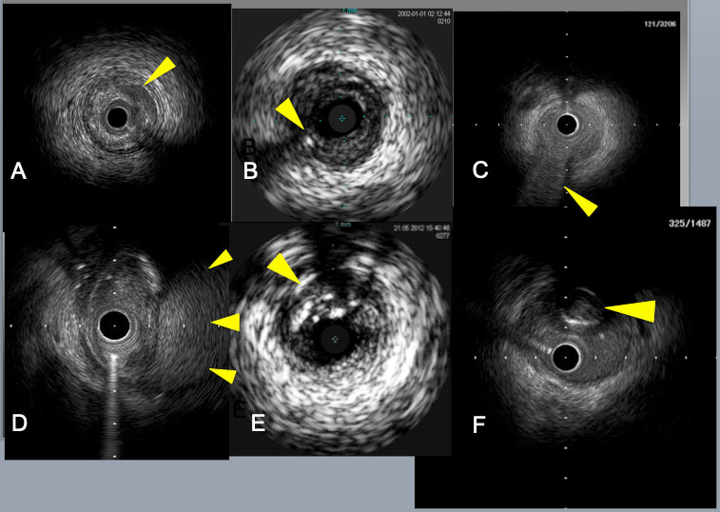

The role of imaging in coronary chronic total occlusion intervention
Figure 4
Subintimal catheter position is indicated by the absence of 3 layers of arterial wall and the presence of the collapsed true lumen in E, F. Crescent shaped mild dissection (an arrow) in A, a retrograde guide wire in intimal plaque ( an arrow) in B, a septal branch bifurcation (an arrow) in C, a big subintimal hematoma (arrows) in D.
Masahisa Yamane, Kenya Nasu, Masaaki Okutsu, Makoto Sekiguchi
©2025 Europa Group - All rights reserved.

