Slide 1


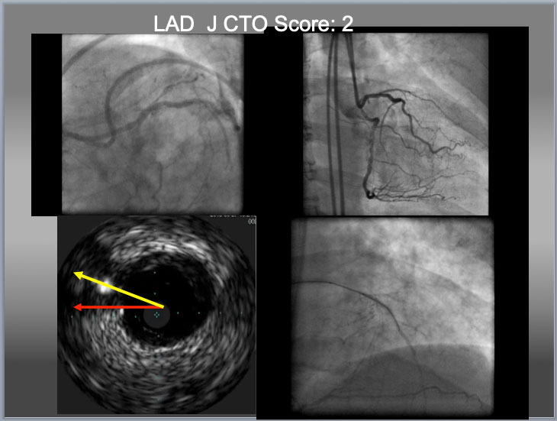

The role of imaging in coronary chronic total occlusion intervention
Figure 5
Eagle Eye IVUS ( Volcano, Philips, Netherland) for LAD CTO ostium identification, Gaia 2 ( additional large 2 curve) for puncture and Gaia 1 ( from package) for crossing. When there is no availability of deflectable tip microcatheter ( such as a Venture Catheter or a Supercross), a penetration wire has to cover the distance (which requires additional curve, to cover a distance in a yellow line, bottom left), to obtain an optimal EA as indicated before. When a wire puncture gets near or at center of the proximal cap, it is high chance that IVUS shows a wire close to or on the line between a center of the main vessel to that of cap ( yellow arrow ). However, the line indicated an red arrow does not necessarily exclude a chance of intraplaque puncture. In this particular case, successful puncture of the proximal cap by IVUS resulted in true to true lumen crossing in the lower right.
Masahisa Yamane, Kenya Nasu, Masaaki Okutsu, Makoto Sekiguchi
©2025 Europa Group - All rights reserved.

