Slide 1


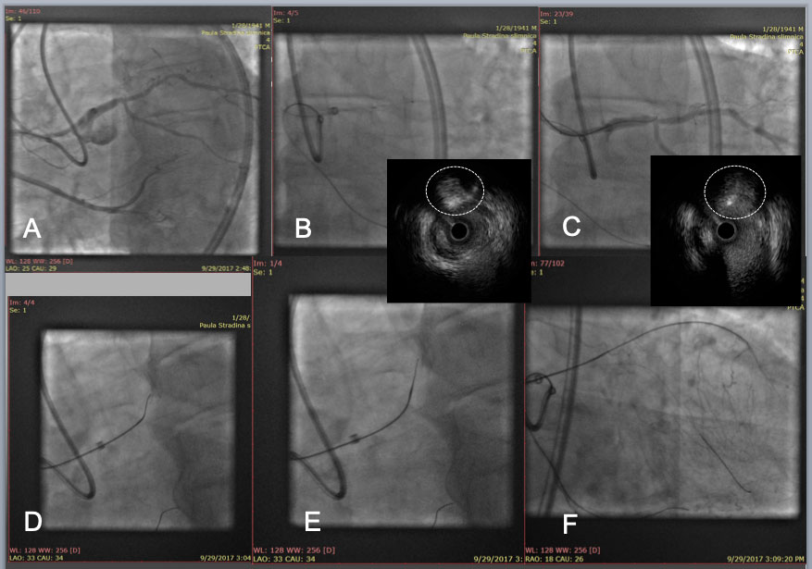

The role of imaging in coronary chronic total occlusion intervention
Figure 6a
LAD CTO with an angulated Proximal plaque plane at a large side branch(A). After IVUS confirmation of the proximal cap (white dotted circle in IVUS, B), a Gaia 2 with a large secondary curve successfully punctured the proximal cap (wire cross section in white dotted circle in IVUS, C), and a Corsair pro was advanced to engage into the proximal cap(D), and an angled Gaia 2 was exchanged to a new Gaia 2 in a pre-shaped tip (E), which allowed the wire tip to enter a distal true lumen (F).
Masahisa Yamane, Kenya Nasu, Masaaki Okutsu, Makoto Sekiguchi
©2025 Europa Group - All rights reserved.

