Slide 1


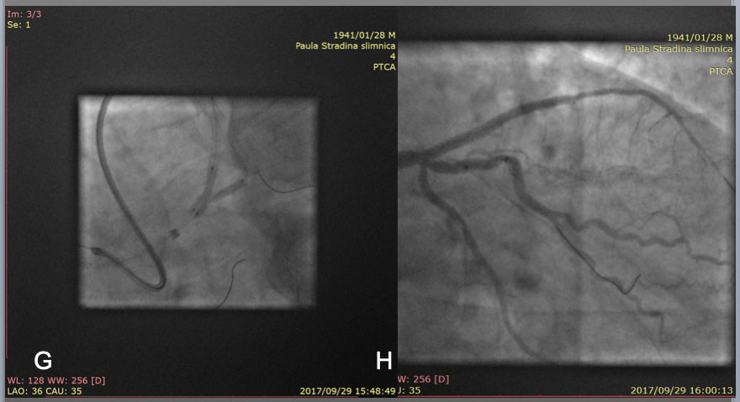

The role of imaging in coronary chronic total occlusion intervention
Figure 6b
After guide wire exchanges, balloon dilation and IVUS pull back, 2 stent strategy deemed to be the best option in this case, so a mini Crush technique was applied for deploying a 3.5mm and a 2.75mm DES over the bifurcation ( left anterior descending artery and intermediate artery, respectively) at conclusion of kissing NC balloon dilation(G). Final result in H.
Masahisa Yamane, Kenya Nasu, Masaaki Okutsu, Makoto Sekiguchi
©2025 Europa Group - All rights reserved.

