Slide 1


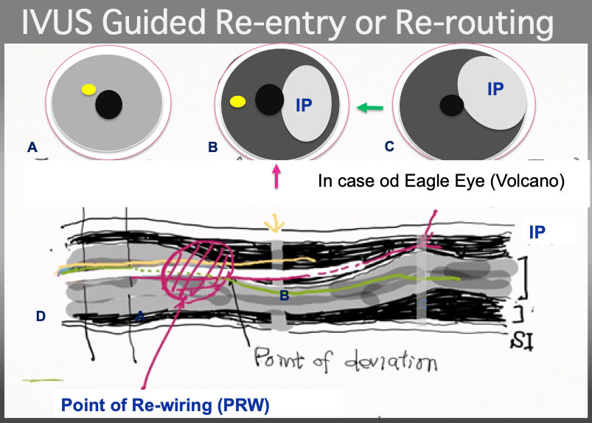

The role of imaging in coronary chronic total occlusion intervention
Figure 7
IVUS Guided wire re-routing. the 2 nd wire (a yellow line) had better pull back to Intimal Plaque (IP) and advance and torque simultaneously counter-clockwise in a illustration to certify that the 2 nd wire is in the Intimal plque in cross section B and C ( although technically, visualization on PR region, and wire re-routing simultaneously is very challenging, especially in bending and /or calcified plaque, partially, IVUS probe restricts a wire movement and hinders deflection control ). Of note, point of wire deviation is, most of the time, located at or neat eccentric calcified plaque or bending or both.
Masahisa Yamane, Kenya Nasu, Masaaki Okutsu, Makoto Sekiguchi
©2025 Europa Group - All rights reserved.

