Slide 1


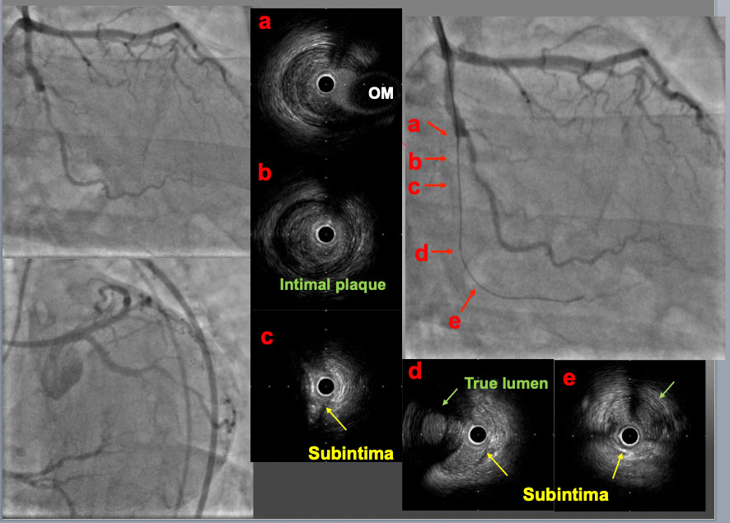

The role of imaging in coronary chronic total occlusion intervention
Figure 8a
A mid LCX-CTO lesion was approached with a 7F. EBU4.0 guide catheter. A first GW was advanced to the proximal PL branch and an IVUS probe was inserted to check the GW position. In the proximal part of the CTO (b), the GW was in intimal plaque. In the mid part (c), the GW was in subintimal space behind a large calcified plaque. In the distal part of CTO (d) and the PL branch (e), the first GW was in subintimal space and so called true lumen (Intimal plaque) was confirmed (green arrow). These IVUS findings indicated that the intimal plaque was positioned on the opposite site of the OM branch (a, c and d).
Masahisa Yamane, Kenya Nasu, Masaaki Okutsu, Makoto Sekiguchi
©2025 Europa Group - All rights reserved.

