Slide 1


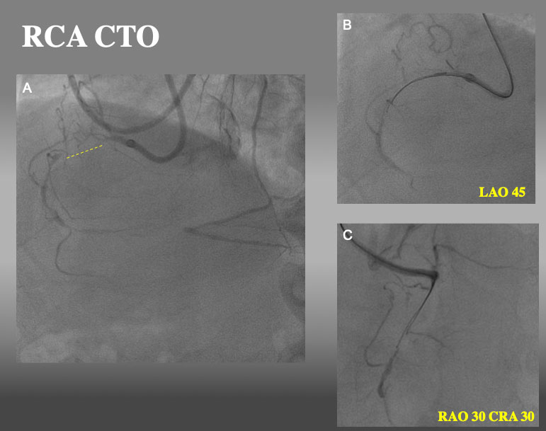

The role of imaging in coronary chronic total occlusion intervention
Figure 9a
Proximal RCA CTO with ipsilateral collateral. After failure of a single wire escalation (GAIA NEXT1→GAINA NEXT 2 and parallel wire technique with SASUKE dual lumen catheter (2nd wire: GAIA NEXT 3), IVUS guided re-wiring was attempted.
Masahisa Yamane, Kenya Nasu, Masaaki Okutsu, Makoto Sekiguchi
©2025 Europa Group - All rights reserved.

