Slide 1


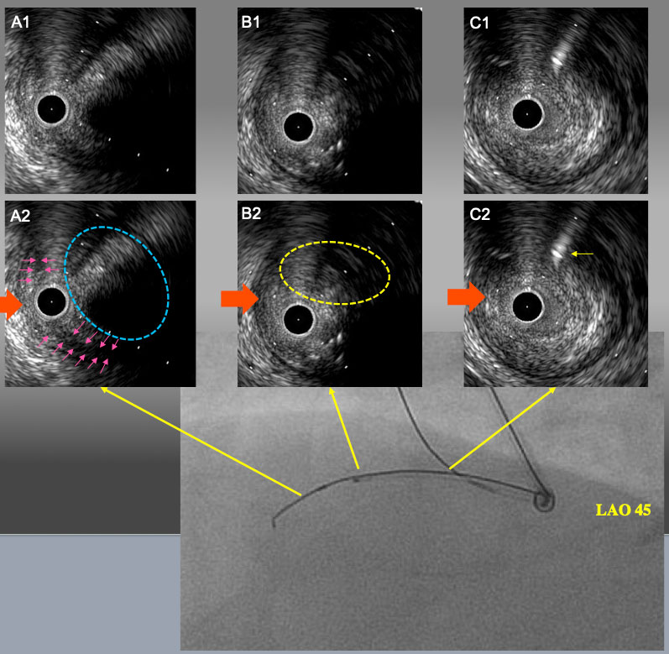
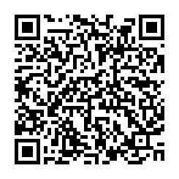
The role of imaging in coronary chronic total occlusion intervention
Figure 9b
IVUS finding and angiogram from LAO 45° after 1.5mm POBA. A1 and A2: IVUS catheter was located in sub-intimal space with a small semi-lunar hematoma (pink arrows). Target intimal plaque was seen at 2 o’clock (blue dot line circle). B1 and B2: the point of deviation. Target intimal plaque was seen at 2 o’clock. C1 and C2: Proximal bifurcation. Guide wire in the conus branch (yellow arrow) came from 1 o’clock. In LAO 45° view, IVUS guide wire and side branch guide wire were seen upper side of IVUVS catheter. Therefore, red arrow is LAO projection in IVUS image.
Masahisa Yamane, Kenya Nasu, Masaaki Okutsu, Makoto Sekiguchi
©2025 Europa Group - All rights reserved.

